Slide 1




SHANMUGANATHAN ENGINEERING COLLEGE (Accredited by NAAC, an ISO 9001:2015 Certified Institution) ARASAMPATTI – 622 507 DEPARTMENT OF ELECTRONICS AND COMMUNICATION ENGINEERING
01
S A A S
WELCOME TO OUR PRESENTATION
02
END-TO-END DEVELOPMENT OF A SAAS APPLICATION
TITLE
HARIPRABU. S [912421106303]
NANDHINI. P [912421106304]

Slide 2
PROJECT
HTML
JAVASCRIPT
CSS

Slide 3


S A A S
APPLICATION
01
02
END-TO-END DEVELOPMENT
USAGE
Industry-specific SaaS Applications
Healthcare
Education
Productivity and Collaboration SaaS Applications
Team Communication Platforms
Document Management Systems
Customer-facing SaaS Applications
Live Chat and Messaging Platforms
E-commerce Platforms
SaaS, or Software as a Service, is a software delivery model where software applications are hosted by a service provider and made available to customers over the internet.
End-to-end development of a SaaS application is a comprehensive approach that involves a systematic process of creating and delivering software as a service.

Slide 4
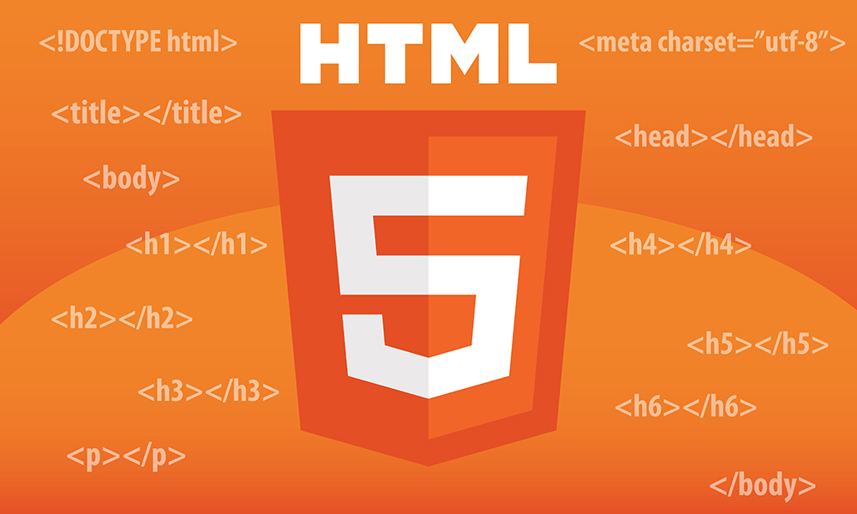

HTML
HTML stands for Hyper Text Markup Language.
HTML is the standard markup language for creating Web pages. HTML describes the structure of a Web page.
HTML consists of a series of elements. HTML elements tell the browser how to display the content.
STEP
STEP
01
04
STEP
STEP
05
02
HTML Elements:
1. Headings: h1-h6
2. Paragraphs: p
3. Links: a
4. Images: img
5. Lists: ul, ol, li
6. Tables: table, tr, td
7. Forms: form, input, textarea
8. Divisions: div
STEP
STEP
03
06

Slide 5
DIFFERENT TYPES OF HTML STYLES
INTERNAL STYLES
EXTERNAL STYLES
INLINE STYLES
01
02
03
Defined within the HTML document using the <style> element.
Applies styles to the entire document.
Defined in a separate CSS file (e.g., styles.css).
Linked to the HTML document using the <link> element.
Defined directly within an HTML element using the style attribute.
Applies styles to a single element.

Slide 6
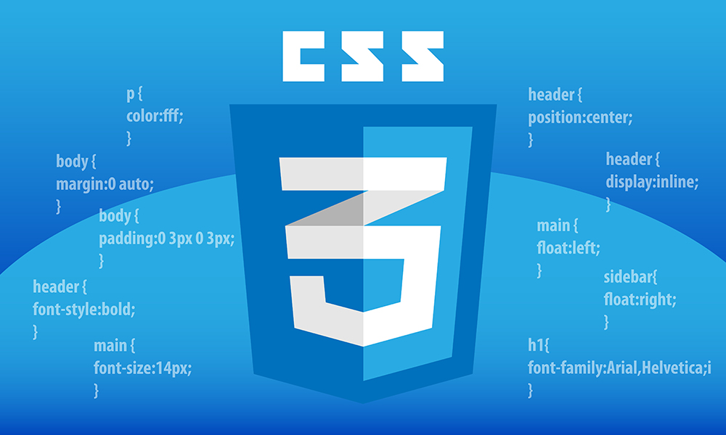
INTRODUCTION TO
CSS
BASICS:
Selectors: Target HTML elements to apply styles.
Properties: Define styles (e.g., color, font-size).
Values: Assign values to properties (e.g., red, 18px).
Rules: Combine selectors, properties, and values.
CSS (Cascading Style Sheets) is a language used to describe the presentation and design of a web page written in HTML. It controls the layout, colors, fonts, and overall look and feel of the website.
CSS allows you to separate the content of your web page (HTML) from the visual design, making your code cleaner and more manageable.

Slide 7



CSS SYNTAX
CSS Properties
Real-World Applications:
selector { property: value; property: value;}
Example:h1 { color: blue; font-size: 36px;
}
Color and Background
Fonts and Text
Layout and Positioning
Borders and Shadows
Transitions& Animations
Flexbox and Grid
Web Design & Development
E-commerce Websites
Social Media Platforms
Mobile Apps

Slide 8


JAVASCRIPT
JAVASCRIPT PURPOSE
JavaScript is a high-level, dynamic, and interpreted programming language used for client-side scripting on the web.
It is a crucial tool for creating interactive and dynamic web pages, web applications, and mobile applications.
1. Add interactivity to web pages.
2. Create dynamic web pages.
3. Develop web applications.
4. Enhance user experience.
5. Validate user input.
JavaScript Applications
1. Web development.
2. Mobile app development.
3. Game development.
4. Desktop applications
5. (IoT) development
PAGE 08
PAGE 08

Slide 9

SYNTAX & STRUCTURE
JAVASCRIPT'S USES
JavaScript's syntax is similar to other programming languages like C and Java, making it relatively easy to pick up if you're familiar with those.
It uses statements, variables, functions, objects, and more to create and manipulate data.
Client-side scripting: JavaScript runs on the client's web browser.
Web application development: JavaScript powers complex web applications.
Mobile app development: JavaScript used in frameworks like React Native and Angular Mobile.
1
2

Slide 10




04
Halloween
E-COMMERCE WEBSITE
GITHUB SOURCE CODE
GITHUB LIVE PAGE
NETLIFY DEPLOY
https://github.com/Hariprabu1734/Halloween.git
https://hariprabu1734.github.io/Halloween/
https://halloweenwebsite2004.netlify.app

Slide 11


Pros and Cons
POSITIVES
Scalability and Flexibility
Lower Costs
Security and Compliance
Performance Dependence on Internet Connectivity
Automatic Updates & Maintenance
Potential for High Competition
Data Privacy and Control Concerns for Users
NEGATIVES

Slide 12









